Slide 1
COMPUTER PROJECT(PYTHON)
-Project by,
Sriram.S
Arun.A
Jenix Andrew

Slide 2
Contents
Aim
Introduction
Python
Elements included
Algorithm
Flowchart
Program code
Output
Reference

Slide 3
Aim
The aim of this project is to design a arithmetic calculator. This project deals with the functioning of a calculator and perform basic arithmetic operators.
We, in this project will see:
Addition of two numbers.
Subtraction of two numbers.
Multiplication of two numbers.
Division of two numbers.

Slide 4
introduction
In this project, we will see how to code to use a basic calculator.
We will, in this program, add, subtract, multiply, divide two numbers using user defined functions.
We will have look of algorithm, flowchart done using flowgorithm, and program, and an output executed.

Slide 5
Python
Python is an interpreted, object-oriented, high-level programming language with dynamic semantics. Its high-level built in data structures, combined with dynamic typing and dynamic binding, make it very attractive for Rapid Application Development, as well as for use as a scripting or glue language to connect existing components together. Python's simple, easy to learn syntax emphasizes readability and therefore reduces the cost of program maintenance. Python supports modules and packages, which encourages program modularity and code reuse. The Python interpreter and the extensive standard library are available in source or binary form without charge for all major platforms, and can be freely distributed.

Slide 6
Elements included
Defined-functions
Return
While
Input
If-Else statement
Print

Slide 7
algorithm
Define functions- add in terms of P and Q
Return as P+Q
Define function- subtract in terms of P and Q
Return as P-Q
Define function- multiply in terms of P and Q
Return as P*Q
Define function- divide in terms of P and Q
Return as P/Q

Slide 8
algorithm
print ("Please select the operation.")
print ("a. Add")
print ("s. Subtract")
print ("m. Multiply")
print ("d. Divide")
While True:
Input choice as (a/s/m/d)
Input x,y

Slide 9
algorithm
if choice == 'a':
print (x, " + ", y, " = ", add(x, y))
elif choice == 's':
print (x, " - ", y, " = ", subtract(x, y))
elif choice == 'm':
print (x, " * ", y, " = ", multiply(x, y))
elif choice == 'd':
print (x, " / ", y, " = ", divide(x, y))
else:
print ("This is an invalid input")

Slide 10
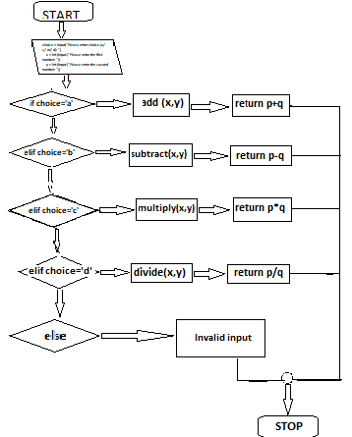
flowchart

Slide 11
Program
def add(P, Q):
# This function is used for adding two numbers
return P + Q
def subtract(P, Q):
# This function is used for subtracting two numbers
return P - Q
def multiply(P, Q):
# This function is used for multiplying two numbers
return P * Q
def divide(P, Q):
# This function is used for dividing two numbers
return P / Q

Slide 12
# Now we will take inputs from the user
print ("Please select the operation.")
print ("a. Add")
print ("s. Subtract")
print ("m. Multiply")
print ("d. Divide")
while True:
choice = input("Please enter choice (a/ s/ m/ d): ")
x = int (input ("Please enter the first number: "))
y = int (input ("Please enter the second number: "))

Slide 13
if choice == 'a':
print (x, " + ", y, " = ", add(x, y))
elif choice == 's':
print (x, " - ", y, " = ", subtract(x, y))
elif choice == 'm':
print (x, " * ", y, " = ", multiply(x, y))
elif choice == 'd':
print (x, " / ", y, " = ", divide(x, y))
else:
print ("This is an invalid input")

Slide 14
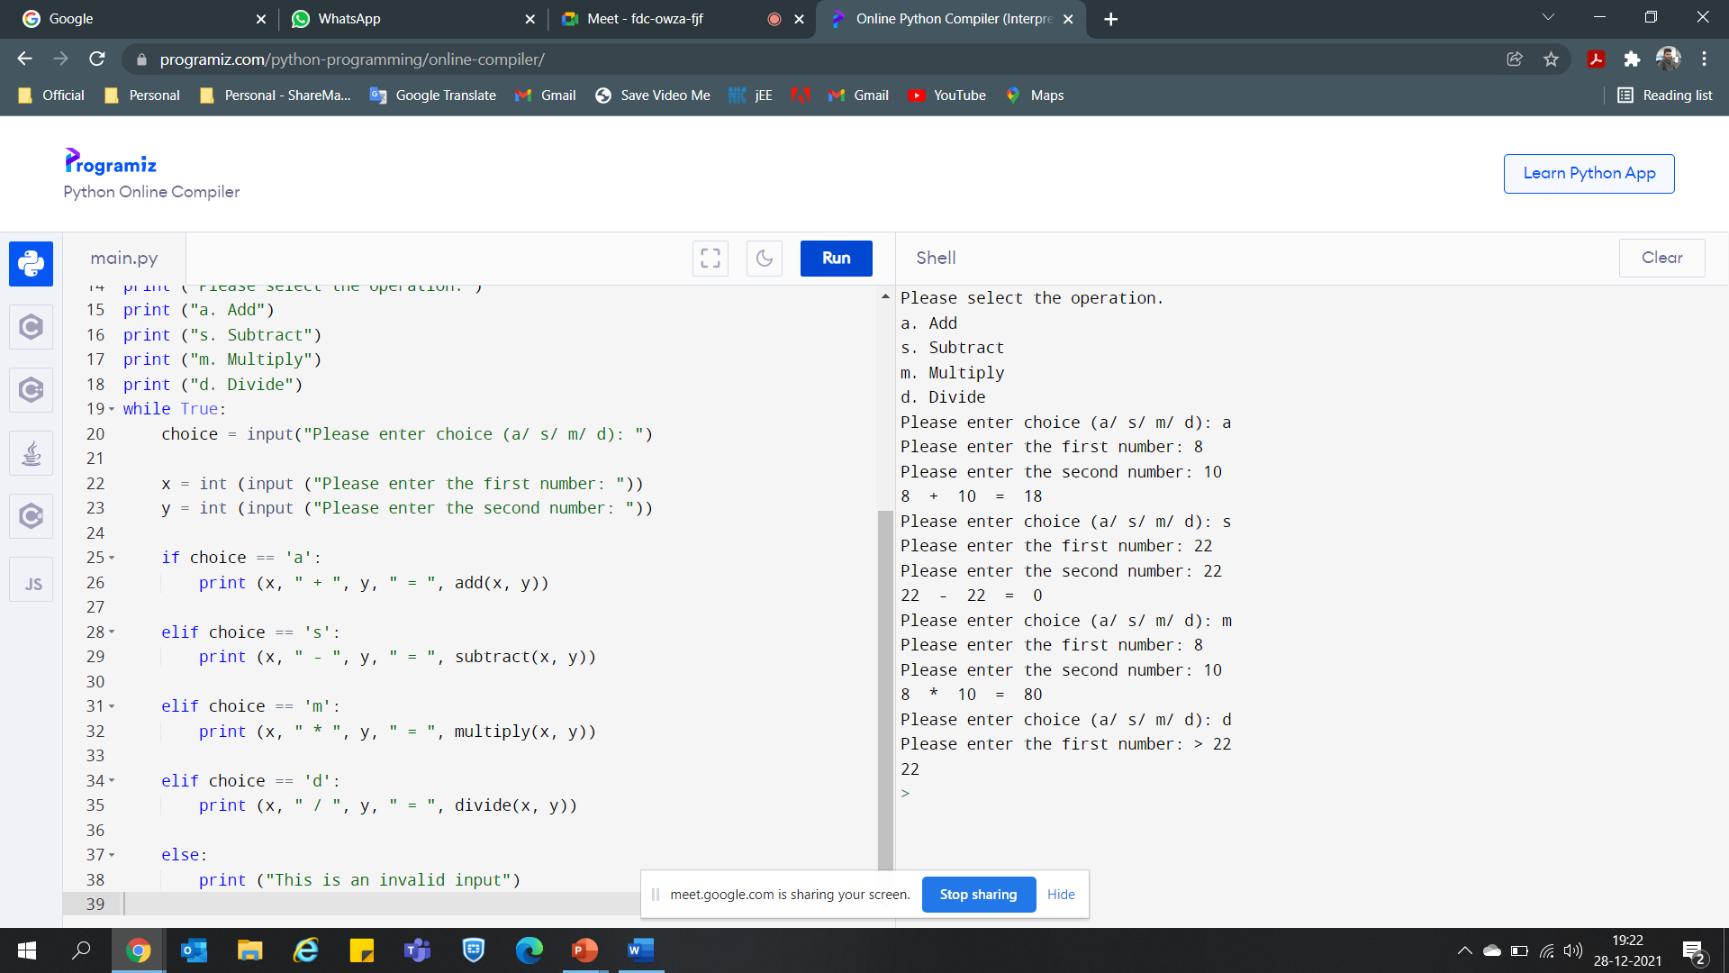
Output:

